Slide 1

Strategic decision making with Microsoft Office Project Portfolio Server 2007
Ben Chamberlain, Senior Product Manager
Aik Chen, Support Escalation Engineer
Microsoft Corporation

Slide 2
Ben Chamberlain
Ben Chamberlain is a product manager in the Microsoft Office Project group. Ben has worked extensively with Global 500 firms to design and implement project and portfolio management solutions. He is an expert in portfolio prioritization and optimization techniques. He joined Microsoft from UMT, where he led a product management team responsible for the creation and commercialization of the UMT Portfolio Manager, which was acquired by Microsoft in January 2006 and is now known as Microsoft Office Project Portfolio Server.

Slide 3
Aik Chen
Aik Chen serves as the global escalation resource for both Project and Project Server. He started with the Premier support team back in 2000 and has contributed to various partner and customer offerings. Aik’s most recent initiative was the Project Server 2003 proactive workshops. Aik is currently working on the content and readiness of the global support teams for Project Portfolio Server.

Slide 4
Special note
The Live Meeting WebCast environment supports animations, transitions, and automatic timing in presentations.
When you view the on-demand archives, some animation features may not work correctly.
To view the presentation with full support for animations, you must download the presentation from the KB article, and view it in Slide Show mode. To do this, open the .ppt file and press F5. Or you can click View Show on the Slide Show menu.
Notes:
2004 MVP Global Summit
April 4-7, 2004
© 2003-2004 Microsoft Corporation. All rights reserved.
This presentation is for informational purposes only. Microsoft makes no warranties, express or implied, in this summary.

Slide 5


Agenda
Microsoft® Office Project Portfolio Server 2007 overview
What is new in Project Portfolio Server 2007
Best practice: Portfolio prioritization and optimization
  Business alignment framework overview
  Business alignment framework demo
Product support
Key resources
Q & A

Slide 6

Office Project Portfolio Server 2007 positioning
Microsoft Office Project Portfolio Server 2007 is a top-down portfolio management solution that helps organizations realize their potential by identifying, selecting, and delivering investments that best align with their business strategy
Objectively prioritize and
evaluate competing
investments
Gain visibility and control
Optimize budget and align
investments with
business strategy
Tightly integrate with
Project Server 2007
Notes:
2004 MVP Global Summit
April 4-7, 2004
© 2003-2004 Microsoft Corporation. All rights reserved.
This presentation is for informational purposes only. Microsoft makes no warranties, express or implied, in this summary.
© 2004 Microsoft Corporation. All rights reserved.
This presentation is for informational purposes only. Microsoft makes no warranties, express or implied, in this summary.

Slide 7
Select and deliver the right investments
Portfolio Management enables organizations to identify and select the investments that will maximize business value
100%
Portfolio
Management
50%
value lost
Project
Management
66%
Project Management
helps ensure that organizations can successfully deliver selected investments and realize the business value
50%
value realized
Ability to identify business value potential (Project Portfolio Server 2007)
0%
75%
100%
Ability to realize business-value potential
(Project Server 2007)
Notes:
2004 MVP Global Summit
April 4-7, 2004
© 2003-2004 Microsoft Corporation. All rights reserved.
This presentation is for informational purposes only. Microsoft makes no warranties, express or implied, in this summary.
© 2004 Microsoft Corporation. All rights reserved.
This presentation is for informational purposes only. Microsoft makes no warranties, express or implied, in this summary.

Slide 8
Manage the synergies between PPM and APM
Project Portfolio Server 2007 includes best-practice portfolio analytical techniques to help organizations manage project, program, and application portfolios
Business strategy
IT strategy
Application
valuation
Portfolio
selection
Application
redundancy
assessment
Application
Portfolio
Management
Application
transformation
decisions
New project requests
Project
capture and
valuation
Project
Portfolio
Management
Portfolio
planning
Application
inventory
update
Portfolio
execution
New or enhanced applications
Notes:
2004 MVP Global Summit
April 4-7, 2004
© 2003-2004 Microsoft Corporation. All rights reserved.
This presentation is for informational purposes only. Microsoft makes no warranties, express or implied, in this summary.
© 2004 Microsoft Corporation. All rights reserved.
This presentation is for informational purposes only. Microsoft makes no warranties, express or implied, in this summary.

Slide 9















Microsoft Office Project Portfolio Server 2007 is a key component in the EPM solution
Project Portfolio Server 2007 integrates with Project Server 2007 to provide organizations with an end-to-end project portfolio management (PPM) solution
Line of business systems
Executives
Portfolio analysts
Project managers
Application managers
Project managers
Executives
Resource managers
Team members
Project Server gateway
Notes:
2004 MVP Global Summit
April 4-7, 2004
© 2003-2004 Microsoft Corporation. All rights reserved.
This presentation is for informational purposes only. Microsoft makes no warranties, express or implied, in this summary.
© 2004 Microsoft Corporation. All rights reserved.
This presentation is for informational purposes only. Microsoft makes no warranties, express or implied, in this summary.

Slide 10
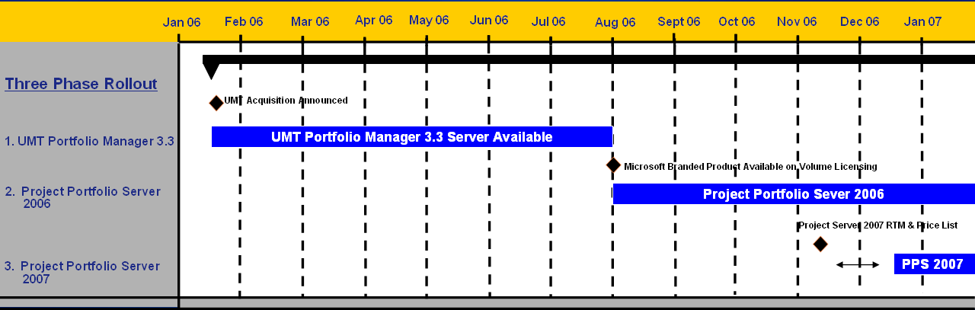
Microsoft Office Project Portfolio Server evolution
Notes:
2004 MVP Global Summit
April 4-7, 2004
© 2003-2004 Microsoft Corporation. All rights reserved.
This presentation is for informational purposes only. Microsoft makes no warranties, express or implied, in this summary.
October 19-20, 2005 -- Microsoft Partner Advisory Council Confidential

Slide 11
Microsoft Office Project Portfolio Server evolution (2)
Three-phase deployment:
  Phase 1: UMT Portfolio Manager 3.3 Server
    Do not go dark!! Make the UMT Portfolio Manager 3.3 Server available post acquisition.
  Phase 2: Office Project Portfolio Server 2006
    Release the first Microsoft–branded version of the product on volume licensing.
  Phase 3: Office Project Portfolio Server 2007
    Release an enhanced version of the product that integrates with Office Project Server 2007 within 30–60 days of Project Server 2007 release date.
Notes:
2004 MVP Global Summit
April 4-7, 2004
© 2003-2004 Microsoft Corporation. All rights reserved.
This presentation is for informational purposes only. Microsoft makes no warranties, express or implied, in this summary.
October 19-20, 2005 -- Microsoft Partner Advisory Council Confidential

Slide 12
What is new in Project Portfolio Server 2007
Released January 2007
  Functional differences:
    Integration with Office Project Server 2007
    Project Portfolio Server interface (PPSI - read-only API)
    Globalization
    Installation wizard
    Schedule tab enhancements
    Improvements to the project-level reports
    Updated logo and log on screen
    Stabilization (varied bug fixes)
Notes:
2004 MVP Global Summit
April 4-7, 2004
© 2003-2004 Microsoft Corporation. All rights reserved.
This presentation is for informational purposes only. Microsoft makes no warranties, express or implied, in this summary.
October 19-20, 2005 -- Microsoft Partner Advisory Council Confidential

Slide 13
What is new in Project Portfolio Server 2007 (2)
Released January 2007 (continued)
  Change in system requirements:
    Integrates with Office Project Server 2007 only
    Integrates with WSS 3.0 for document management
Notes:
2004 MVP Global Summit
April 4-7, 2004
© 2003-2004 Microsoft Corporation. All rights reserved.
This presentation is for informational purposes only. Microsoft makes no warranties, express or implied, in this summary.
October 19-20, 2005 -- Microsoft Partner Advisory Council Confidential

Slide 14
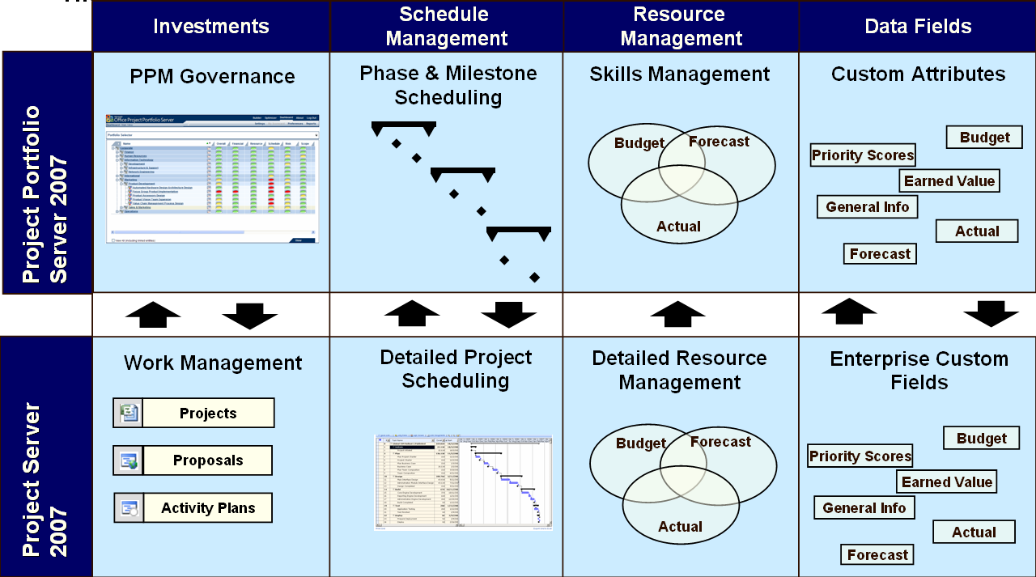
Microsoft Office Project Portfolio Server 2007
Integration with Project Server 2007
Re-engineered: The Project Server Gateway in MOPPS 2007 has been rewritten to use the new Project Server interface (PSI) API in Office Project Server 2007. MOPPS 2006 relied on Project Data Services (PDS) API to communicate with Project Server 2003.
Backward compatibility: MOPPS 2007 only integrates with Project Server 2007.
Work management: MOPPS 2007 can import all work from Project Server 2007 (full projects, proposals, and activity plans).
(Note MOPPS 2007 does not currently integrate with the Resource Plan component of proposals and activity plans)
Notes:
2004 MVP Global Summit
April 4-7, 2004
© 2003-2004 Microsoft Corporation. All rights reserved.
This presentation is for informational purposes only. Microsoft makes no warranties, express or implied, in this summary.
October 19-20, 2005 -- Microsoft Partner Advisory Council Confidential

Slide 15
Microsoft Office Project Portfolio Server 2007
Project Portfolio Server Interface (PPSI)
Overview: The Office Project Portfolio Server Interface (PPSI) is a set of read-only Web Service APIs that expose a subset of the data in MOPPS 2007.
Usage: Customers and partners can use the read-only API to export attributes into third-party reporting solutions and custom reports.
Data exposed: The Project Portfolio Server Interface (PPSI) exposes the following datasets:
  Default attributes: For example, project name, project ID, workflow class, workflow status, and others.
  Custom attributes: Users create attributes by using the Attribute Definition Wizard.
MOPPS 2007
Project Portfolio Server Database
Read/
Write
Project Portfolio Server Web Access
Project Portfolio
Server
Read Only
Project Portfolio Server Interface (PPSI)
Typed datasets
Third-party applications
Custom reports

Slide 16

Microsoft Office Project Portfolio Server 2007
Globalization
Overview: MOPPS 2007 has been enhanced to support international globalization requirements.
  Regional Settings: MOPPS 2007 will support a majority of Windows® standard locales except for those based on non-Gregorian calendars. The solution will support varied date and time settings, currencies, and number formats based on the server settings as well as the end-user selected locale.
  Configuration: The administrator is required to select the default currency and regional setting when configuring MOPPS 2007.
  User interface: The user interface in MOPPS 2007 has not been localized. It is available only in U.S. English..
  Unicode: MOPPS 2007 supports Unicode to make sure that users can enter data in their own languages.
  Note Unicode can be displayed, but not edited, in the ActiveX® controls.

Slide 17
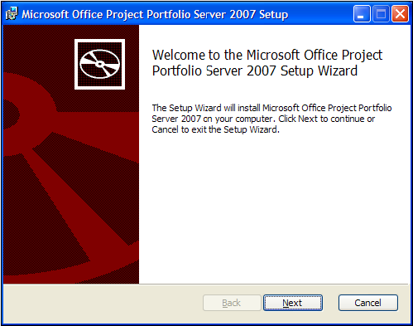
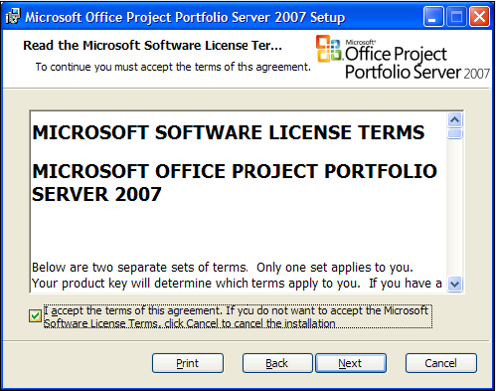
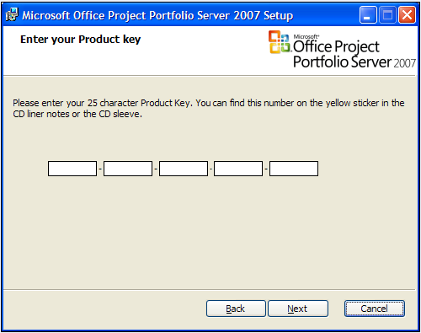
Microsoft Office Project Portfolio Server 2007
Development of an installation wizard
  The new MSI significantly enhances the MOPPS 2007 installation experience

Slide 18
Microsoft Office Project Portfolio Server 2007
Schedule tab enhancements
The following improvements have been made to the Schedule tab:
  Tab design: The schedule tab has been redesigned to improve usability.
  Project-level scheduling: The user has the choice to either capture schedule data at the project level, or break down by key phases or milestones.
  Actual dates: The user can capture actual dates for phases and milestones and also planned and forecast dates. The forecast dates are automatically updated in accordance with the actual dates.
  Link milestones to phases: Users can add milestones under the appropriate project phases.
  Comments: Users can add comments to each phase and milestone.

Slide 19
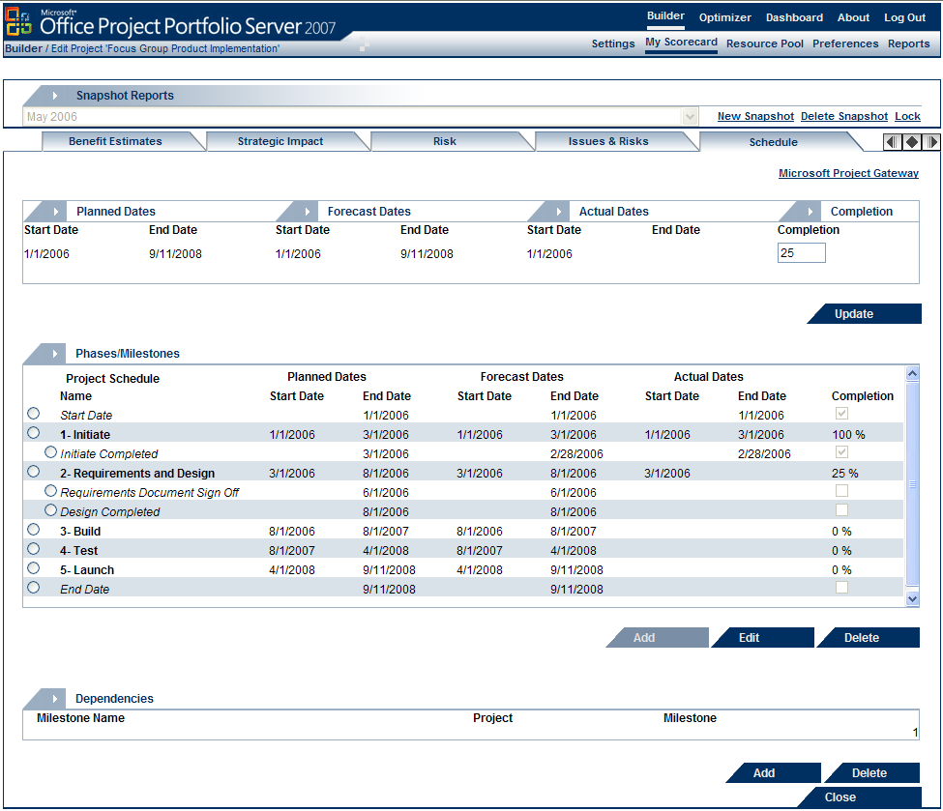
Microsoft Office Project Portfolio Server 2007
Schedule tab enhancements (screen shot)

Slide 20
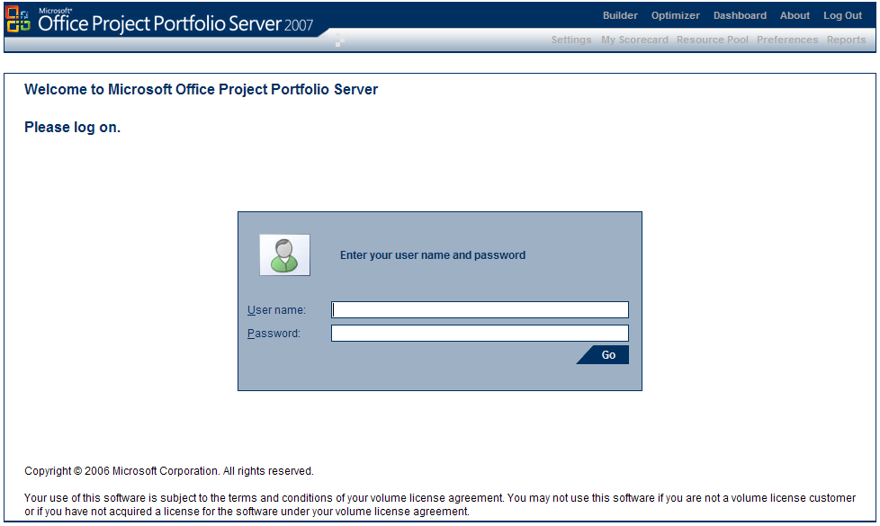
Microsoft Office Project Portfolio Server 2007
Updated product logo and logon screen

Slide 21
Embedded Portfolio Management best practices Business alignment framework
‘The Business Alignment Framework ensures a rational rather than emotional approach to project selection’
Define
Prioritize
Optimize
Select
1
2
Define business
drivers and impact statements
Prioritize business drivers
4
5
Optimize Project Requests
Optimize project requests
3
Assess the portfolio
constraint analysis
advanced analysis
Select portfolio
New project requests
Prioritize requests
Strategic value
Financial value
Risk
Carry-over requests

Slide 22

Business alignment framework
Business driver definition (theory)
Business drivers are a series of short, sharp statements that express the shared focus of the organization in actionable terms
Strategic goal 1
Strategic goal 2
Business driver 1
Business driver 3
Business driver 2
Business driver 4
Business driver criteria:
  They address a strategic goal
  They are actionable
  They are measurable
  They are attainable
  They are unique
  They are clear to decision makers
Notes:
2004 MVP Global Summit
April 4-7, 2004
© 2003-2004 Microsoft Corporation. All rights reserved.
This presentation is for informational purposes only. Microsoft makes no warranties, express or implied, in this summary.

Slide 23
Business alignment framework
Business driver definition (example)
Strategic goal:
Dedicate our resources to those market areas where we can maintain our existing client base and increase share of market of current clients
Business driver name:
Business driver name:
Retain existing clients
Grow customer share of wallet
Business driver definition:
Business driver definition:
Maintain clients and remain competitive in existing markets
Sell additional products to existing clients
KPIs:
KPIs:
Client satisfaction rates
Client retention rates
Variance in % market share
% increase of market share
Increase in revenue
Notes:
2004 MVP Global Summit
April 4-7, 2004
© 2003-2004 Microsoft Corporation. All rights reserved.
This presentation is for informational purposes only. Microsoft makes no warranties, express or implied, in this summary.

Slide 24

Business alignment framework
Impact statement definition (theory)
Impact statements are derived from KPIs and are used to quantify the impact of each project request against each of the business drivers.
Business driver 1
Business driver 2
Extreme
Extreme
Strong
Project
Strong
Moderate
Moderate
Low
Low
No Impact
No impact
The role of impact measures:
Impact statements are defined by the senior management team.
Impact statements provide a quantifiable link between the measurable business drivers and the project requests.
The impact statements should clearly communicate the metrics that define the level of impact a project request may have on business drivers.
  Note: Existing KPIs, balanced scorecard, and other metrics may be used.
Impact statements ensure that each project requests impact on the business drivers are evaluated consistently using the same the same metrics.

Slide 25
Business alignment framework
Impact statement definition (example)
Driver name:
Grow customer share of wallet
Definition:
Sell additional products to existing clients
Associated KPIs
Thresholds
Impact statements
Extreme
Increases revenue per client by more than 15% and increases market share by 5%
% Increase of
market share
Increase in
revenue
Strong
Increases revenue per client by between 8% -14.99% and increases market share by 2% - 4.99%
Moderate
Increases revenue per client by between 3% - 7.99% and increases market share by up to 1.99%
Low
Increases Revenue per client by up to 2.99% and increases Market Share by up to 1.99%
Notes:
2004 MVP Global Summit
April 4-7, 2004
© 2003-2004 Microsoft Corporation. All rights reserved.
This presentation is for informational purposes only. Microsoft makes no warranties, express or implied, in this summary.

Slide 26
Business alignment framework
Portfolio prioritization and optimization demo
‘The business alignment framework ensures a rational rather than emotional approach to project selection’
Define
Prioritize
Optimize
Select
1
2
Define business
drivers & impact statements
Prioritize business drivers
4
5
Optimize Project Requests
Optimize project requests
3
Select
portfolio
Assess the portfolio
Constraint analysis
Advanced analysis
New project
requests
Prioritize requests
Strategic value
Financial value
Risk
Carry-over
requests

Slide 27
Support and implementation considerations
Microsoft supports the following versions of Office Project Portfolio Server:
  PPS 2006 and PPS 2007
Partner and consultant involvement:
  Super important and is key to a successful implementation
  Consider longer term engagements for larger or complex implementations
Notes:
2004 MVP Global Summit
April 4-7, 2004
© 2003-2004 Microsoft Corporation. All rights reserved.
This presentation is for informational purposes only. Microsoft makes no warranties, express or implied, in this summary.
October 19-20, 2005 -- Microsoft Partner Advisory Council Confidential

Slide 28
Support and implementation considerations (2)
Support avenues
  Work closely with your sales contact
  Premier Support
  Professional Support
  Microsoft Consulting Services (MCS)
  Public newsgroups
Notes:
2004 MVP Global Summit
April 4-7, 2004
© 2003-2004 Microsoft Corporation. All rights reserved.
This presentation is for informational purposes only. Microsoft makes no warranties, express or implied, in this summary.
October 19-20, 2005 -- Microsoft Partner Advisory Council Confidential

Slide 29
Resources and key dates
MOPPS 2007 resources:
  MOPPS 2007 Web site: http://office.microsoft.com/en-us/portfolioserver_x000b_/default.aspx
  MOPPS on the partner portal:
  https://partner.microsoft.com/US/program/competencies/iwsolutions/40029164
  Deployment Guide:
  http://www.microsoft.com/downloads/details.aspx?
  FamilyId=8977C122-A64F-4C4E-A78B-
  EA8E150FE3A&displaylang=en
(Note that the URLs on this page and the next should be entered as one line; they are wrapped here for readability.)

Slide 30
Resources and key dates (2)
MOPPS 2007 Reference (continued):
  Programmer Reference:
  http://www.microsoft.com/downloads/details.aspx?
  FamilyId=18848D8B-6784-4E6A-B716-96D571EEB676&displaylang=en
  User guides will be released in second quarter 2007
EPM University:
  The following courses will be available through EPMU in March 2007:
    Architecting EPM (Project Portfolio Server 2007 Focus)
    Implementing EPM (Project Portfolio Server 2007 Focus)

Slide 31
Thank you for joining us for today’s event.
For information about all upcoming Support WebCasts, and access to the archived content (streaming media files, PowerPoint® slides, and transcripts), visit the Support WebCast site at http://support.microsoft.com/WebCasts/
We sincerely appreciate your feedback. Please submit any comments or suggestions about the Support WebCasts on the “Contact Us” page of the Support Web site at http://support.microsoft.com/servicedesks/webcasts/feedback.asp.
© 2007 Microsoft Corporation. All rights reserved.
This presentation is for informational purposes only. Microsoft makes no warranties, express or implied, in this summary.

